Slide 1
Data Mining and Text Mining Project
Bip xTech - Sales Forecast
Paticchio Alessandro Saverio, Sandrelli Federico, Santambrogio Davide, Scorsolini Philippe, Tricarico Andrea
10/06/2018

Slide 2
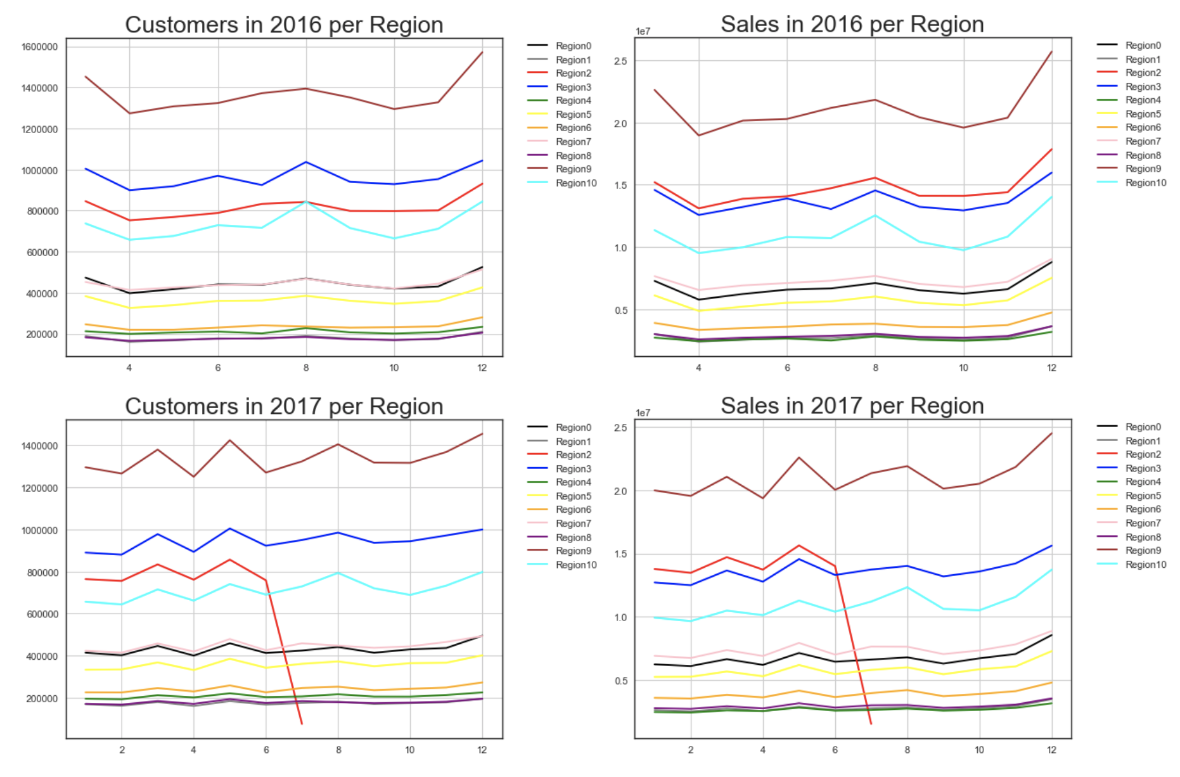
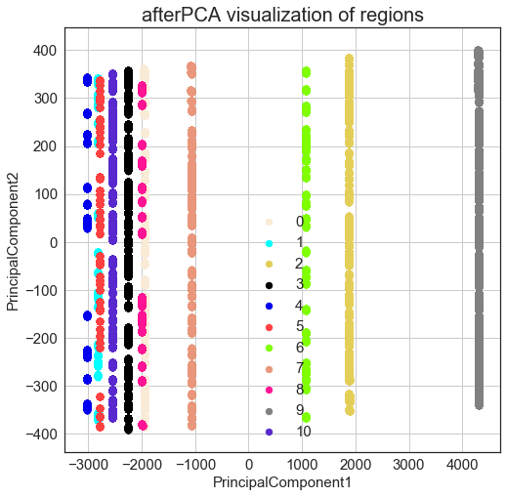
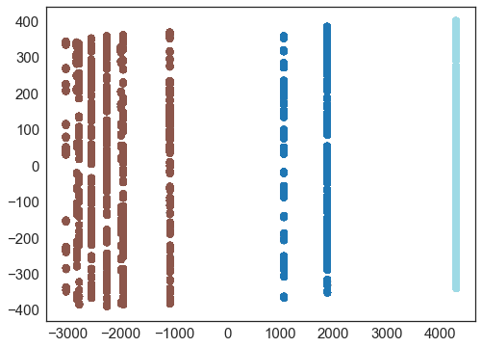
Data Exploration
Sales Trends Visualization
PCA
k-means clustering (k = 3)
{Region 9}
{Region 2, Region 6}
{Region 0, Region 1, Region 3, Region 4, Region 5, Region 7, Region 8, Region 10}

Slide 3
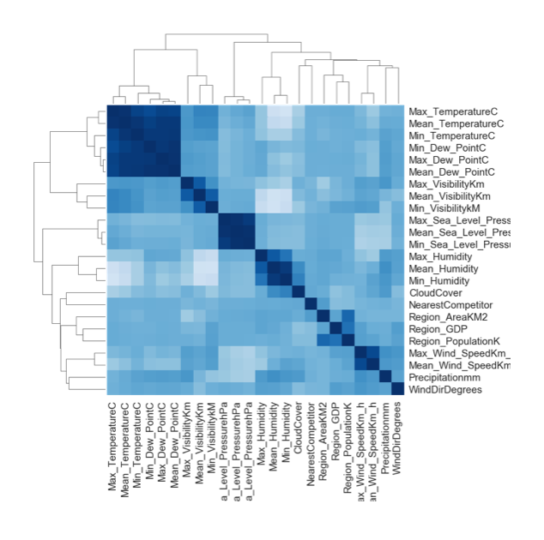
Preprocessing
Dropping [IsOpen==0]
Dealing with Missing Values
Events
Handling Outliers
Normalization
np.log1p to all the numerical variables with a skewness greater than 0.75
Correlation Analysis
Max_Dew_PointC
Min_Dew_PointC
Max_Sea_Level_PressurehPa
Mean_Sea_Level_PressurehPa
Max_Gust_SpeedKm_h

Slide 4
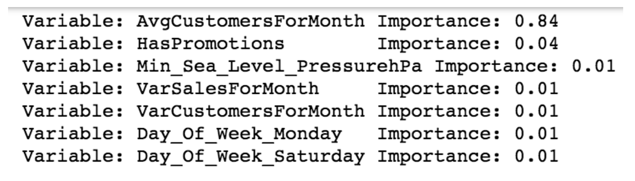
Model Training
Feature Manipulation
AvgSalesForMonth
VarSalesForMonth
AvgCustomersForMonth
AvgCustomersForMonth
Feature Selection
A two-step Approach
1) NumberOfCustomers Prediction
2) Sales Prediction
Random Forests

Slide 5
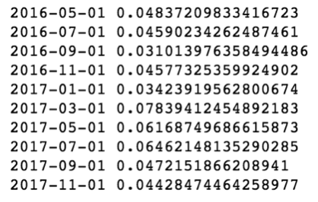

Model Evaluation
The dataset is divided 2-month periods, for each period we apply the error function
Error Function
10-fold Cross-Validation

